Slide 1

Mission critical software
Defensible moats versus AI disruption risk
03 MARCH 2026

Slide 2
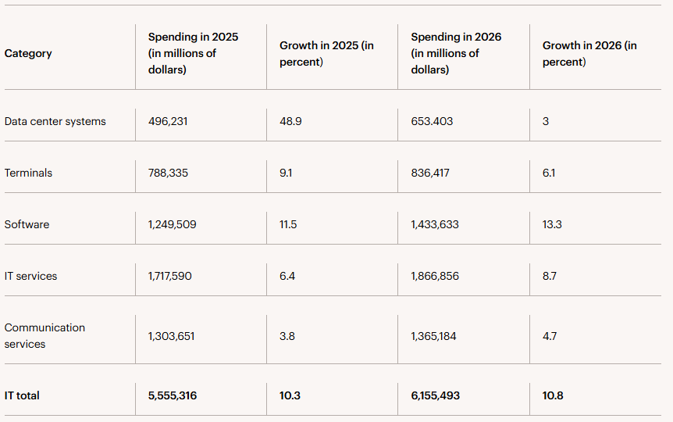
Global IT spend surpasses USD 6tr
USD 6.15tr total in 2026, +10.8% YoY: Worldwide IT spending is expected to reach USD6.15 trillion in 2026
Software up ~15% to USD 1.43tr: Gartner expects software to be the second fastest growing tech category, with spending rising nearly 15% year over year to USD1.43 trillion.
GenAI model spend +80.8%: Projections for generative AI model spending in 2026 remain unchanged, with growth expected at 80.8%.
Source: Gartner, February 2026

Slide 3
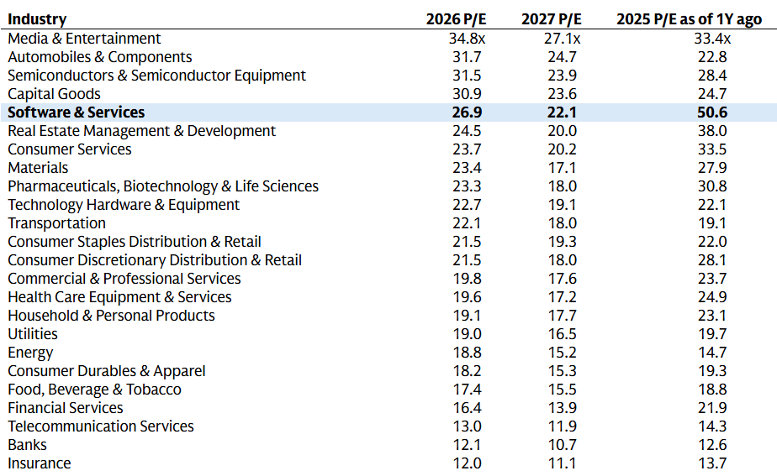
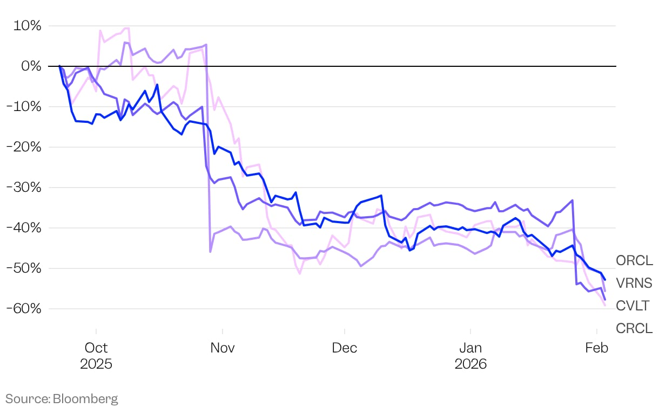
A 47% multiple compression over past 12 months
Software has rerated from 51x to 27x P/E, moving from the most expensive industry in equities to the middle of the pack. Four sectors now trade at a higher multiple.
Some of the worst returns in software stocks since September 2025 high
Source: Goldman Sachs, February 2026

Slide 4
Business case
The market is applying an indiscriminate “AI disruption” discount across software, underweighting the resilience of systems-of-record with high switching costs, deep workflow integration, and multi-year contractual revenue.

Slide 5
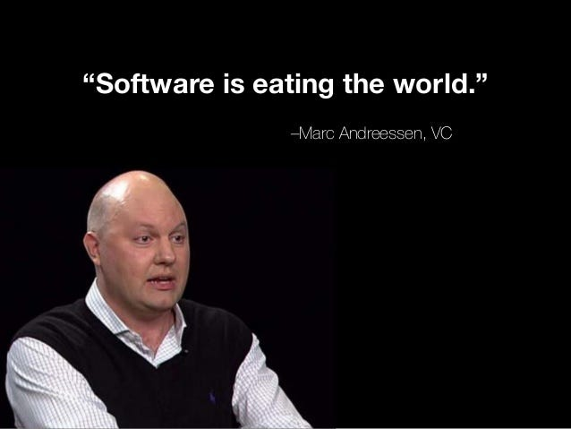
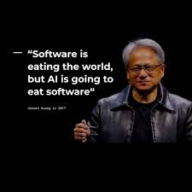
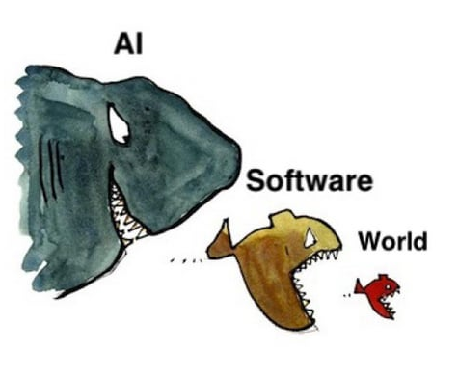
The narrative arc
From software dominance to AI disruption, two quotes that frame the market's fear.
Wall Street Journal, August 2011
NVIDIA GTC, May 2017

Slide 6
AI versus SaaS: Bull vs Bear case
Bull Case
Bear Case
1
Sell-off was sentiment, not fundamental
SAP, Oracle, and ServiceNow fell 26–40% while posting accelerating subscription growth. The market repriced the narrative, not the numbers.
1
AI is deflationary for software pricing
Building a meaningful SaaS product now costs under $10K in compute. Bespoke alternatives will erode incumbent ARPU before AI upsell revenue fills the gap.
2
AI is an upsell, not a replacement
Salesforce Agentforce at $800M ARR (+169% YoY) shows AI monetising on top of existing platforms. The AI layer expands ARPU.
2
Seat-based models are structurally broken
Hiring freezes and layoffs directly reduce seats, capping expansion revenue and triggering downsell in CRM, ITSM, and workflow tools.
3
Regulatory spend provides a valuation floor
NIS2 enforcement is active across the EU in 2026 and SEC cyber rules are live in the US. Cybersecurity has the most defensible near-term revenue visibility.
3
Fragmented data is the incumbents’ trap
AI agents are blind when data sits across 50 disconnected apps. This hands a clean opening to unified AI-native challengers.

Slide 7
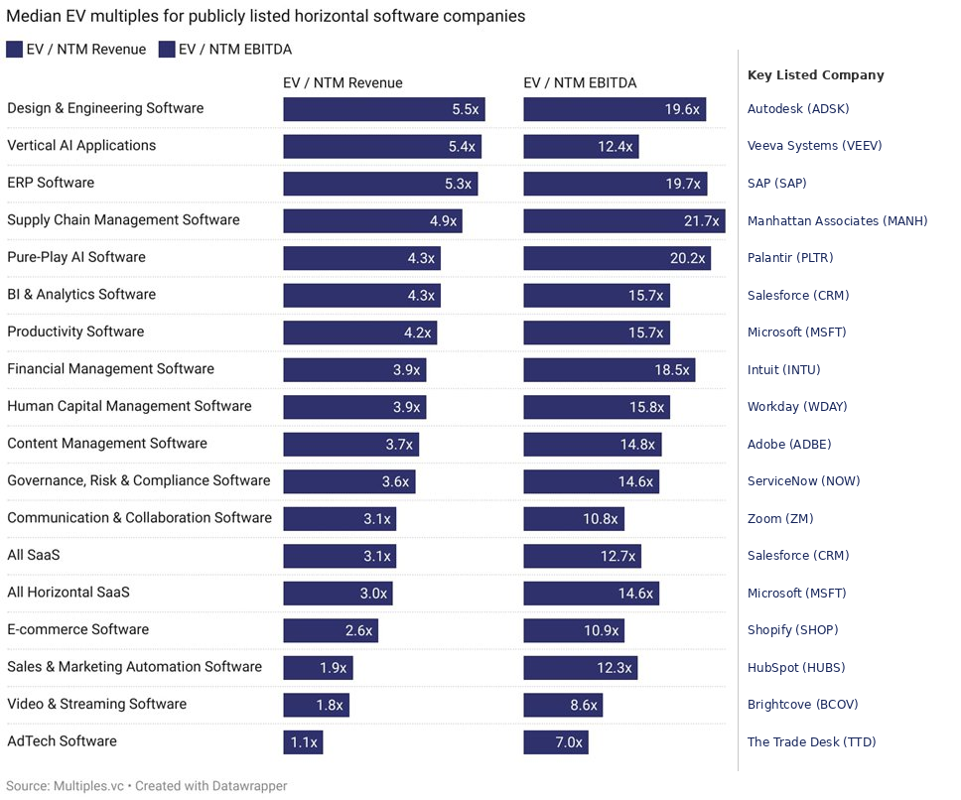
Horizontal software is the most vulnerable
Horizontal software is designed to be used across a wide variety of industries because it solves a general business problem rather than a niche one. It focuses on broad functionality (like bookkeeping or email) that is universal to almost any type of company.
Vertical software (also known as "niche" software) is purpose-built for a specific industry or "vertical," such as healthcare, construction, or retail. It includes specialized features and workflows that are only relevant to that particular field.
ERP stands for Enterprise Resource Planning: Instead of having separate programs for accounting, sales, and warehouse management that don't talk to each other, an ERP brings them all into one "source of truth."
Source: Multiples.vc, November 2025

Slide 8
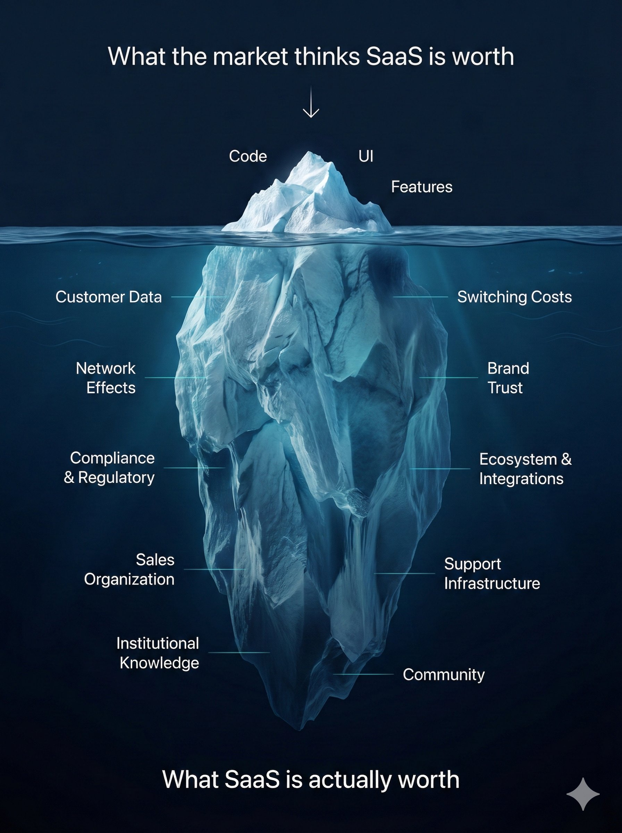
But SaaS is not just a bundle of code
The "SaaSpocalypse" thesis reduces software companies to lines of code, ignoring everything below the surface.
The real moats are customer networks, integration ecosystems, proprietary data, institutional trust, and sales organizations.
If code is cheap for everyone, the winners will be the companies that are great at everything except the code.

Slide 9
SaaS companies saw it coming
Software job postings are down ~70% from 2022 peak.

Slide 10
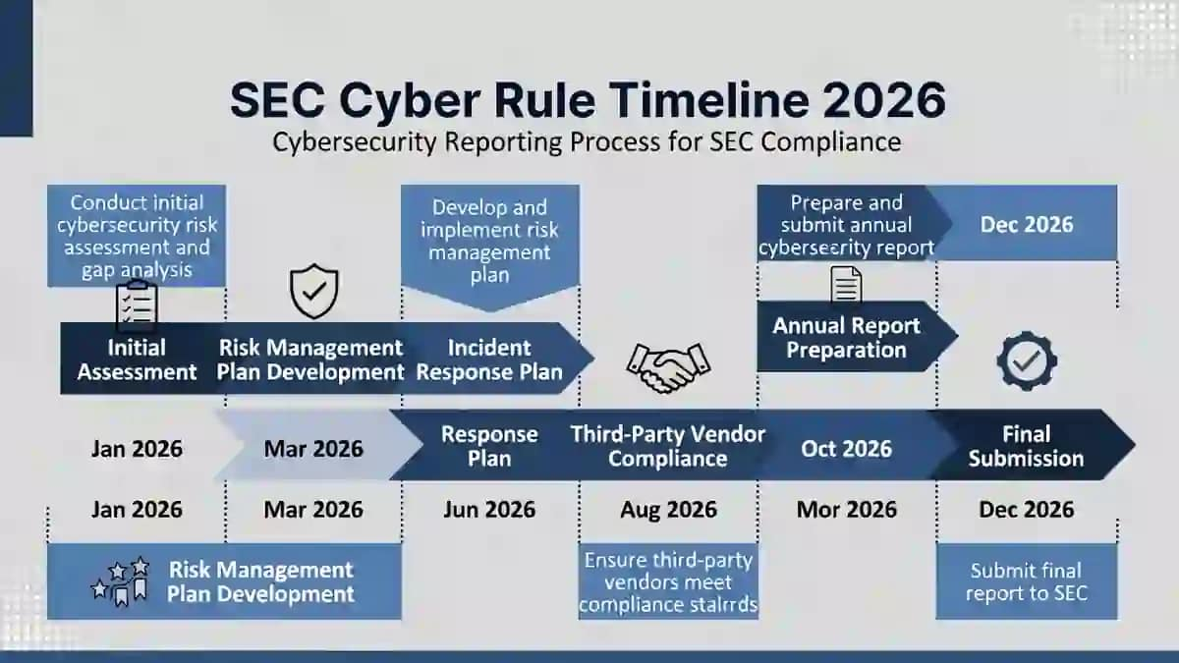
Special case: Cybersecurity
Being compliant isn’t optional it is mandatory. No room for mistake.
AI-driven attacks up 72% YoY, detection windows collapsed to 11 minutes thus it accelerates platform security demand, doesn't commoditize it

Slide 11
What to look for
net retention trends

Slide 12
What to look for
Example text

Slide 13
Header
Example text

Slide 14
Header
Example text

Slide 15
Header
Example text

Slide 16
Header
Example text

Slide 17
Print-friendly cover slide
Subheader here
MONTH 2024

Slide 18
Chapter slide

Slide 19
Chapter slide
MONTH 2026

Slide 20
Print-friendly chapter slide

Slide 21
Cape color palette
Reference these colors when you want access to the full Cape color palette
To use the the Eyedropper tool in PowerPoint, select the object you want to color, then go to Shape Fill or Text Fill on the Format tab and click the Eyedropper tool. You can then click on any color within your presentation, an image, or even outside the presentation window (by clicking and dragging) to apply that color to the selected object.
You can also copy/paste HEX codes by clicking one of the colors below and going to Shape format > Shape fill > arrow down > more fill colors… > HEX color
Main colors
Main colors (shades)
Secondary colors
REFERENCE ONLY – REMOVE BEFORE PUBLISHING

Slide 22
Cape Capital AG Important notice and disclaimer
This presentation is for sophisticated/qualified investors only.
Cape Capital AG does not offer investment services to, or solicit such services to the general public. The information herein is exclusively intended for the private use of the addressee. Any form of duplication or distribution is prohibited by law.
Past performance is not guidance for future performance.
Updated in 2024 Cape Capital AG, Zurich.
All rights reserved.

